Slide 1
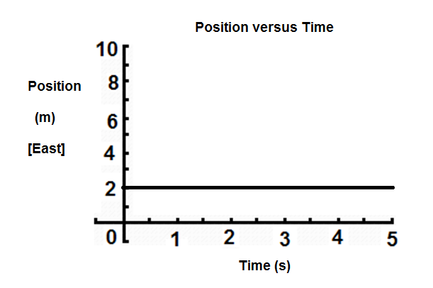
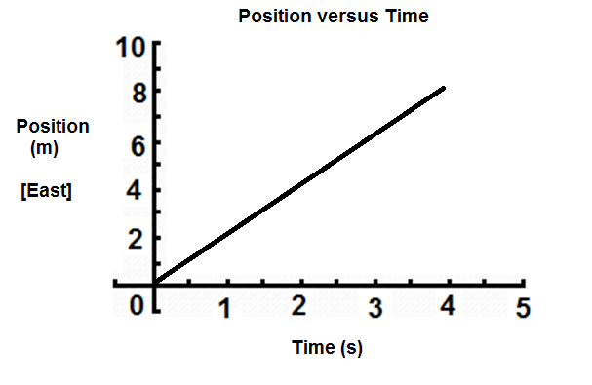

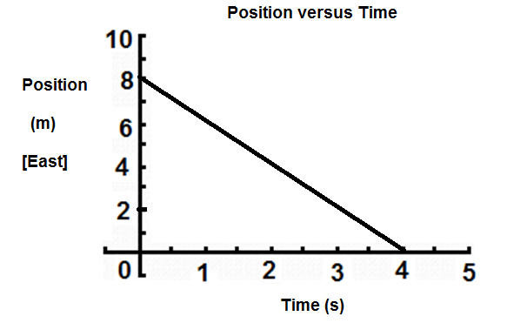
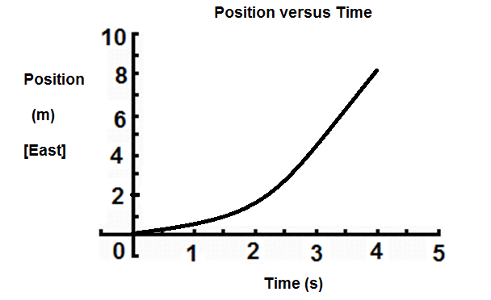
Minds-On: Graphs for Uniform Motion
Which of the following position-time graphs represents the motion of an object moving at a constant velocity of 2.0 m/s [East]?
B
A
C
D

Slide 2
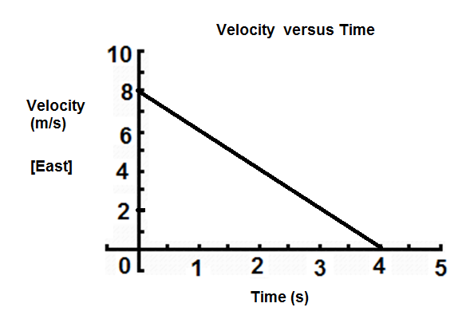
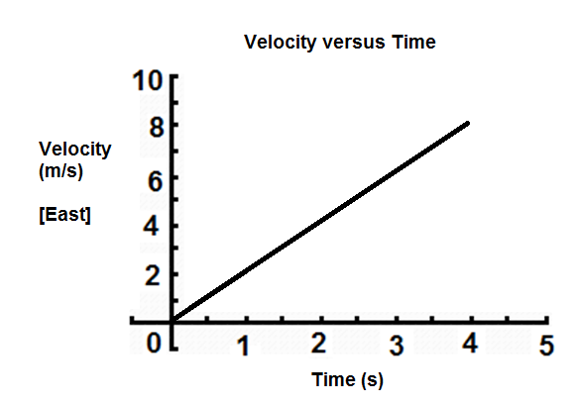
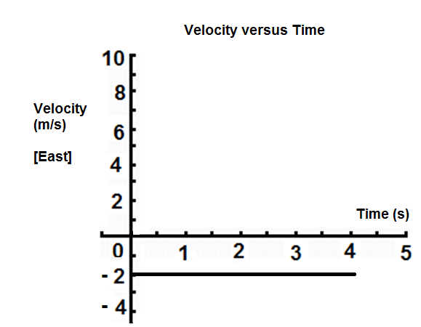
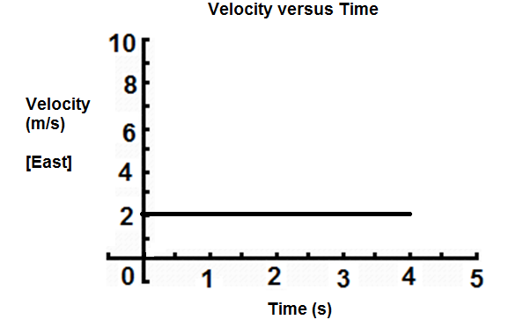
Minds-On: Graphs for Uniform Motion
Which of the following velocity-time graphs represents the motion of an object moving at a constant velocity of 2.0 m/s [East]?
A
B
D
C

Slide 3
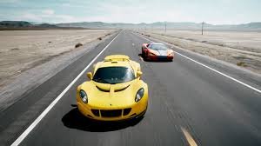
Graphs for Uniform Motion
Uniform Motion: when an object is moving at a constant velocity
-this means it maintains a constant speed in a constant direction
Example: a car travelling on a straight highway
at 100 km/h [West]

Slide 4
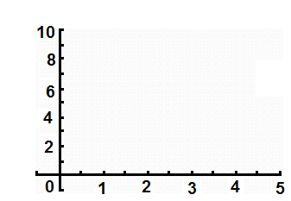
Position-Time Graph
Example: Consider a person walking at a constant velocity of 2.0 m/s [East]. How will the position-time graph of their motion appear?
Time (s) | Position from origin (m) [E]
0.0 | 0.0
1.0
2.0
3.0
4.0
5.0
Position vs. Time
●
●
2.0
●
Position (m) [E] of origin
4.0
●
6.0
●
8.0
●
10.0
Time (s)

Slide 5
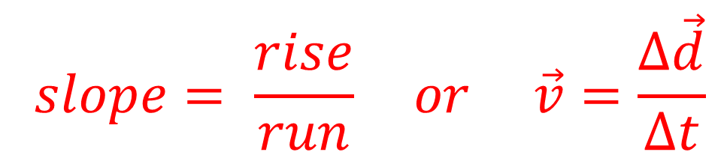
Finding Velocity from a Position –Time Graph
Velocity = slope of position-time graph
$$slope= \frac{rise}{run} or \vec{v}=\frac{∆\vec{d}}{∆t}$$
Velocity = Δd
Δt
Position vs. Time
●
●
= 8.0 -2.0 (m)[E]
4.0 - 1.0 s
●
Position (m) [E] of origin
Rise = Δd
●
= 6.0 (m)[E]
3.0 s
●
Run = Δt
●
= 2.0 m/s [E]
Time (s)

Slide 6
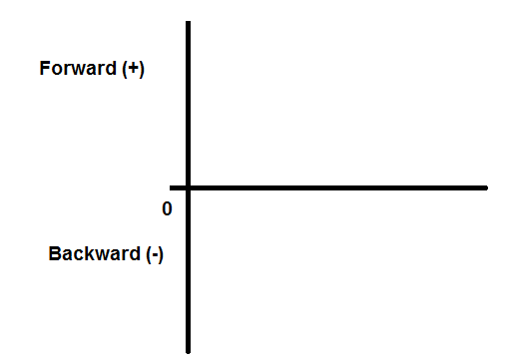
Examples of Motion:
1) Starting at the origin, moving forward and then coming to a stop!
2) Starting from behind origin, moving forward past origin at constant velocity and then coming to a stop!

Slide 7
Examples of Motion:
3) Starting in front of origin, moving backwards past origin at constant velocity
4) Starting in front of origin, moving backwards but coming to a stop before reaching the origin, then moving forward.

Slide 8
Examples of Motion:
A
5) Two cars, A and B, moving forward from origin at constant velocity- A moving faster than B!
B
6) A toy car moves forward from origin at a constant velocity, stops for a moment, then turns around and returns to the origin at a higher speed!

Slide 9
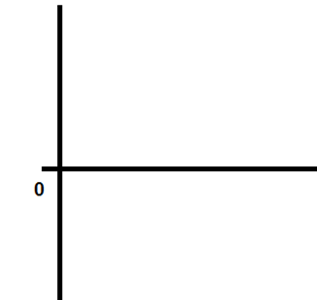
Velocity-Time Graphs for Uniform Motion
An object is moving forward at a constant velocity of 2.0 m/s [Forward] from the origin. How does the velocity –time graph appear?
Position versus Time
Velocity versus Time
2.0
Position (m) [E]
Velocity (m/s) [E]
Time (s)
Time (s)
The velocity is constant!
The velocity –time graph is a straight, horizontal line!

Slide 10
Velocity –Time Graph for Backward Motion
An object is moving at a constant velocity of 2.0 m/s [Backward]. How does the velocity –time graph appear?
Position versus Time
Velocity versus Time
Position (m) [E]
Velocity (m/s) [E]
Time (s)
Time (s)
-2.0 m/s
Let: Forward = + , Backward= - ….. Then the velocity is -2.0 m/s!
The velocity –time graph is a straight horizontal line but it is below the x-axis!

Slide 11
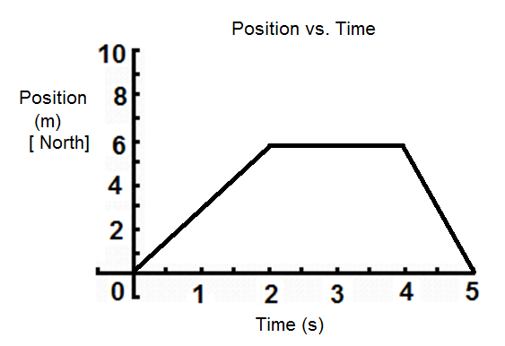
Example: Calculate the slopes of each segment of the
D-T graph below and draw the corresponding V-T graph.
(4,6)
(2,6)
(5,0)
(0,0)

Slide 12
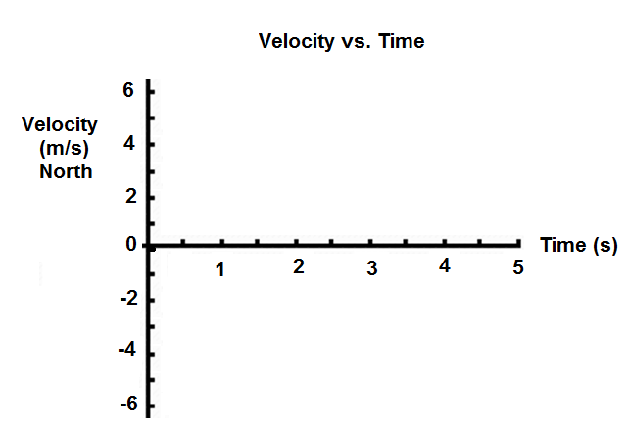
Solution:

Slide 13
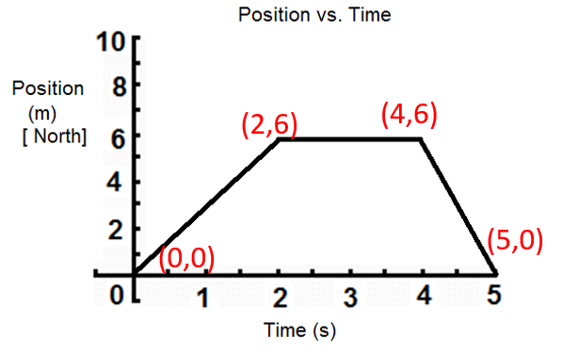
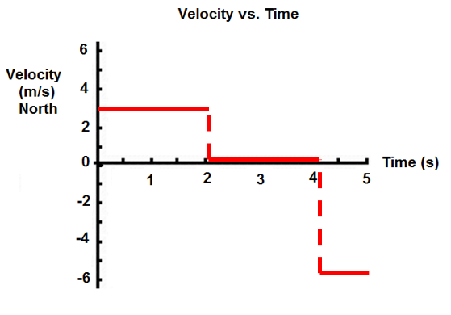

Slide 14
Summary:
Constant velocity in the forward (positive) direction looks like a
_____________________ on a position-time graph.
straight diagonal line
2. Constant velocity in the forward (positive) direction looks like a
_____________________ on a velocity-time graph.
straight horizontal line
3. To find the velocity from a position-time graph for uniform motion
you take the _____________________.
slope

